Slide 1
K Nearest Neighbor
CMPUT 328
Nilanjan Ray
Computing Science, University of Alberta, Canada

Slide 2
Supervised machine learning: the tabular view
Output / Prediction / dependent variable
Independent variable (aka features or predictors)
x
y
Map (Sup. ML)
x₁ | x₂ | x₃ | x₄ | y
1.2 | -3.9 | 4.0 | 0 | 1.6
2.1 | 2.4 | -0.7 | -0.2 | 1.2
… | … | … | … | …
… | … | … | … | …
3.2 | … | … | 1.9 | 0.3
1.4 | … | … | 1.5 | ?
3.1 | … | … | 2.1 | ?
ML learns to map x to y
In other words, ML learns
a function, f so that
y = f(x)
Training data: complete table
The function f is called prediction function
Test data: incomplete table

Slide 3
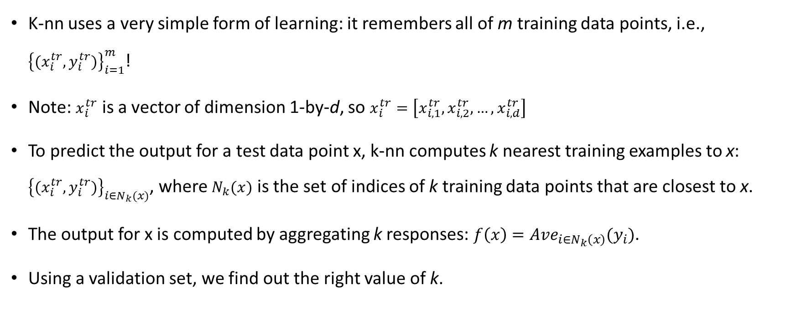
K nearest neighbor (K-nn)
K-nn uses a very simple form of learning: it remembers all of m training data points, i.e., ${\left\{(x_{i}^{tr},y_{i}^{tr})\right\}}_{i=1}^{m}$!
Note: $x_{i}^{tr}$ is a vector of dimension 1-by-d, so $x_{i}^{tr}=\left[x_{i,1}^{tr},x_{i,2}^{tr},…,x_{i,d}^{tr}\right]$
To predict the output for a test data point x, k-nn computes k nearest training examples to x: ${\left\{(x_{i}^{tr},y_{i}^{tr})\right\}}_{i∈N_{k}(x)}$, where $N_{k}(x)$ is the set of indices of k training data points that are closest to x.
The output for x is computed by aggregating k responses: $f\left(x\right)={Ave}_{i∈N_{k}\left(x\right)}(y_{i})$.
Using a validation set, we find out the right value of k.

Slide 4
K-nn: A toy example
x₁ | x₂ | y
2 | -1 | 0
3 | 2 | 1
0 | 4 | 0
-2 | 5 | 0
2 | 0 | 1
1 | 1 | ?
To find out k=3 nearest neighbors, compute distances:
D₁([1, 1], [2, -1]) = |1-2|+|1+1| = 3
D₂([1, 1], [3, 2]) = |1-3|+|1-2| = 3
D₃([1, 1], [0, 4]) = |1-0|+|1-4| = 4
D₄([1, 1], [-2, 5]) = |1+2|+|1-5| = 7
D₅([1, 1], [2, 0]) = |1-2|+|1-0| = 2
So, k=3 nearest neighbors are
N₃([1,1]) = {1, 2, 5}
Prediction for test data point:
f([1, 1]) = Ave([y(1), y(2), y(5)])
= Ave([0, 1, 1]) = 1
Here, we computed “Ave” by taking mode.
Training data, m = 5
Test data point
For this problem, note that the
feature vector dimension, d=2
Let’s assume k = 3

Slide 5
How to find the right value of k?
Divide training data into two sets: training (90%) and validation (10%).
For each k in a range, find out k-nn prediction accuracy on the validation set.
Choose the k that has yielded the highest accuracy on the validation set.

Slide 6
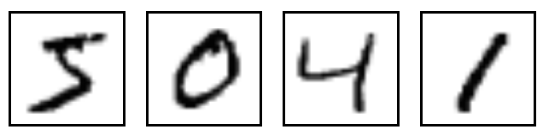
MNIST digit image classification
Pixel values (feature)
Digit
Small 28 pixels-by-28 pixels images of hand written digits
The visual recognition problem definition:
to recognize the digit from an image
x₁ | x₂ | … | x₇₈₄ | y
0.1 | 0.3 | … | 0.0 | 0
0.2 | 0.1 | … | 0.5 | 1
… | … | … | … | …
… | … | … | … | …
0.0 | 0.98 | … | 0.8 | 9
0.5 | 0.25 | … | 0.36 | ?
0.1 | 0.95 | … | 0.1 | ?
We can attempt to solve this using k-nn.
Feature dimension, d = 28 * 28 = 784
Training data
Test data
A recommended resource: https://cs231n.github.io/classification/

